Slide 1
Blackboard Website Remake
Ricardo
Matthew
Umme
Chanesh
Renee

Slide 2
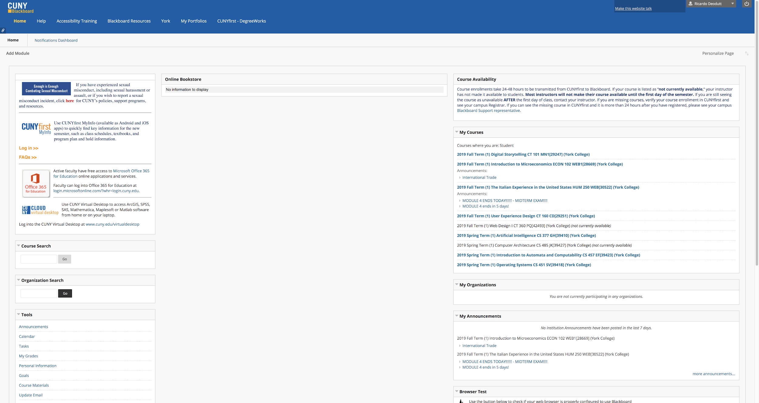
Original Website

Slide 3
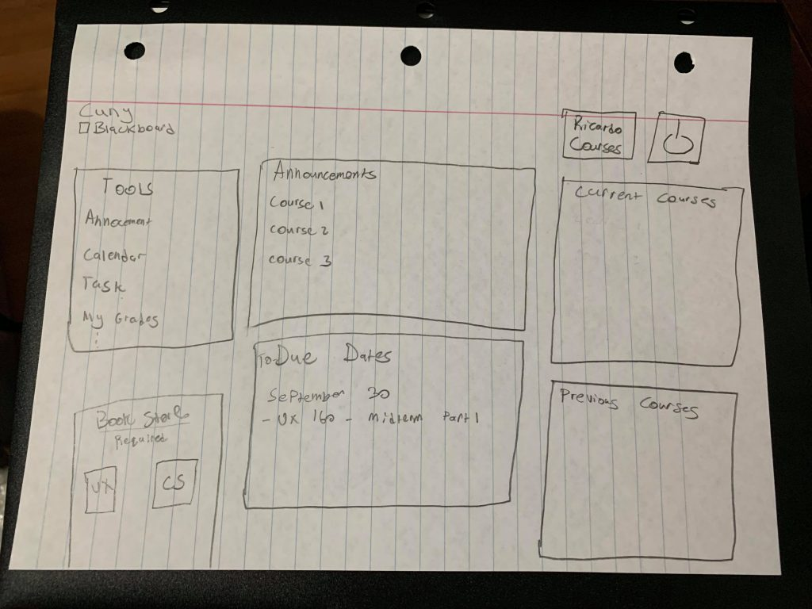
Our thoughts
As a group, our goal is to change Blackboard. Our group wanted to…
Simplify it
Modernize it
Add more Customizable features
The image to the left our initial plans on how we wanted to lay out the remade website.

Slide 4
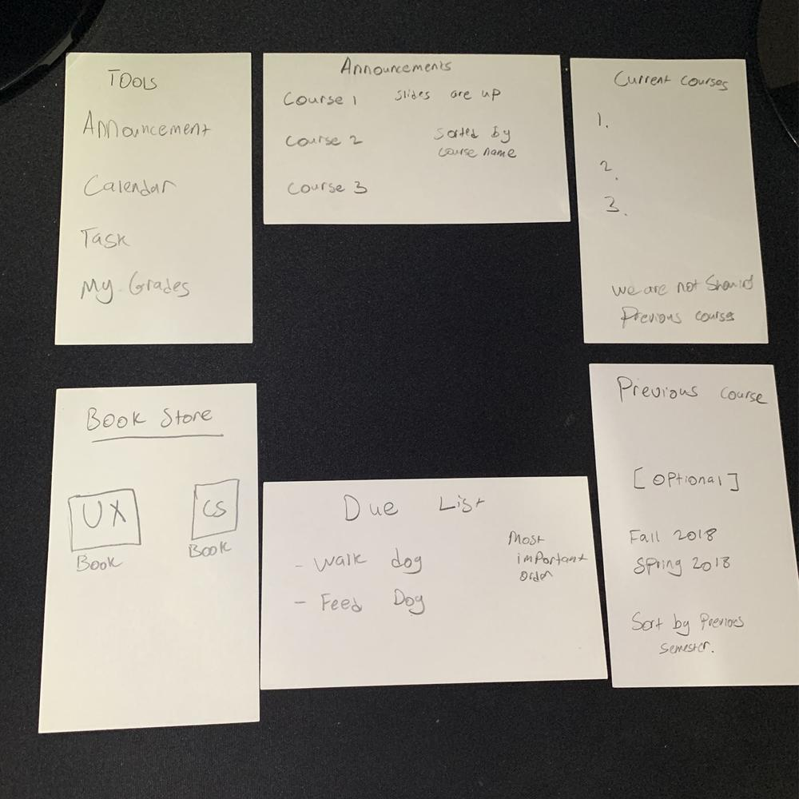
Card Sorting
The following image below shows our website layout using index cards.
We briefly talked about LATCH features we wanted to add in certain sections.

Slide 5
Survey - Data Results

Slide 6
What's the demography?
Well, all of our users are students of CUNY so they are all required to use Blackboard and at least be familiar with the idea of Blackboard.
17 users.
College students from York, Queens, John Jay, City, Hunter, NY City Tech, BMCC.
Most of the users are juniors and seniors. Along with a freshman and graduate student.

Slide 7
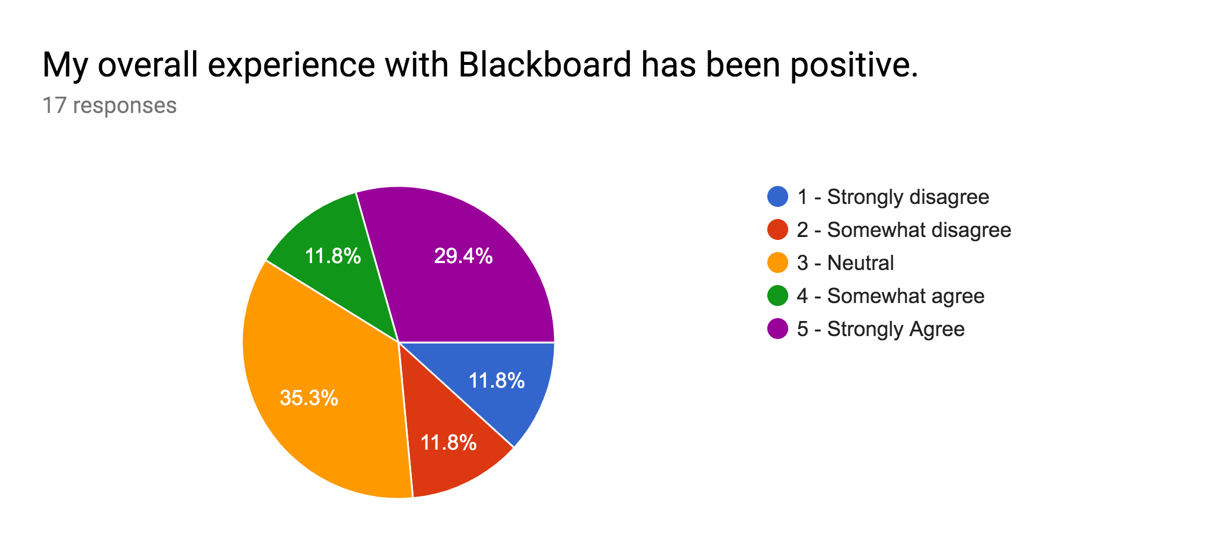

Slide 8
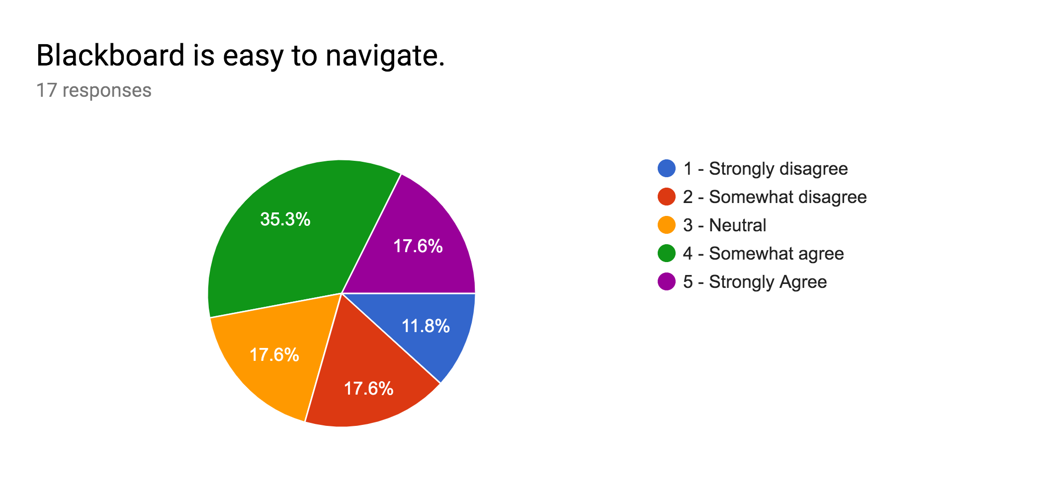

Slide 9
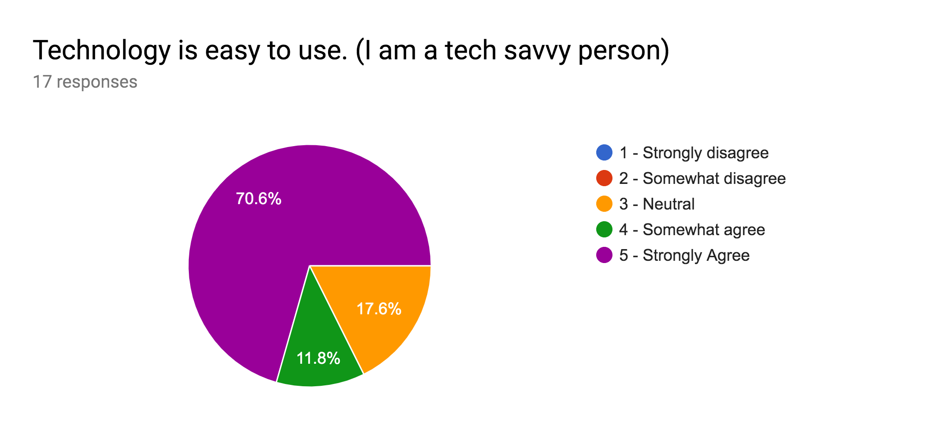

Slide 10
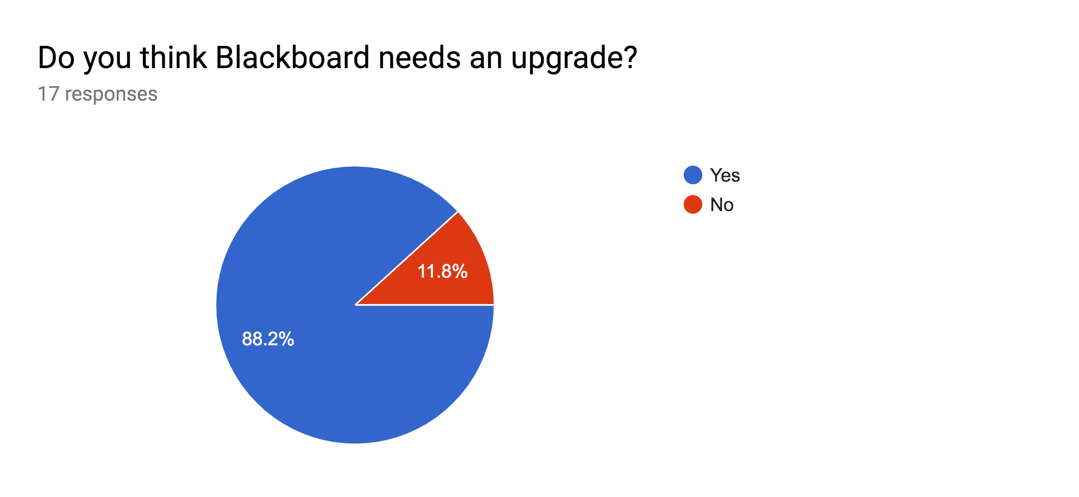

Slide 11
What is the most requested change in Blackboard?
Style change of the course layout
Change to notification bar and status

Slide 12
Notable Responses from Survey
“Take out old previous courses.” - Bishajit L.
“Make notification bar bigger and fill in blank space.” - Matthew H.
“Change colors based on school colors.” - Saurav S.
“Tear the whole thing down and simplify it.” - Md. F.
“Remove useless information and place important parts like my courses on the top.” - Amrit S.

Slide 13
Paper Prototype

Slide 14
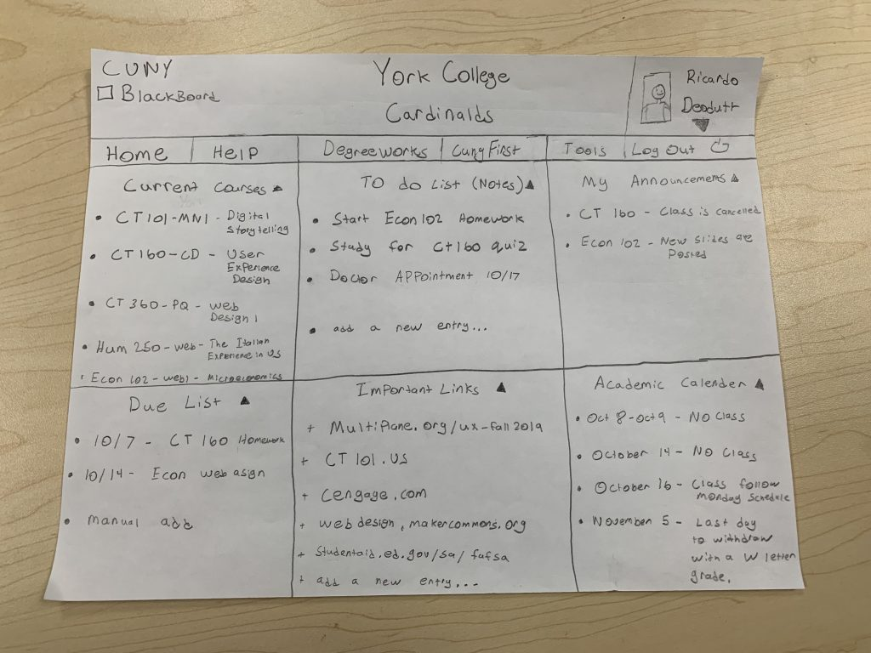
Grid format (no empty spaces), customizable sections, and filtered courses.

Slide 15
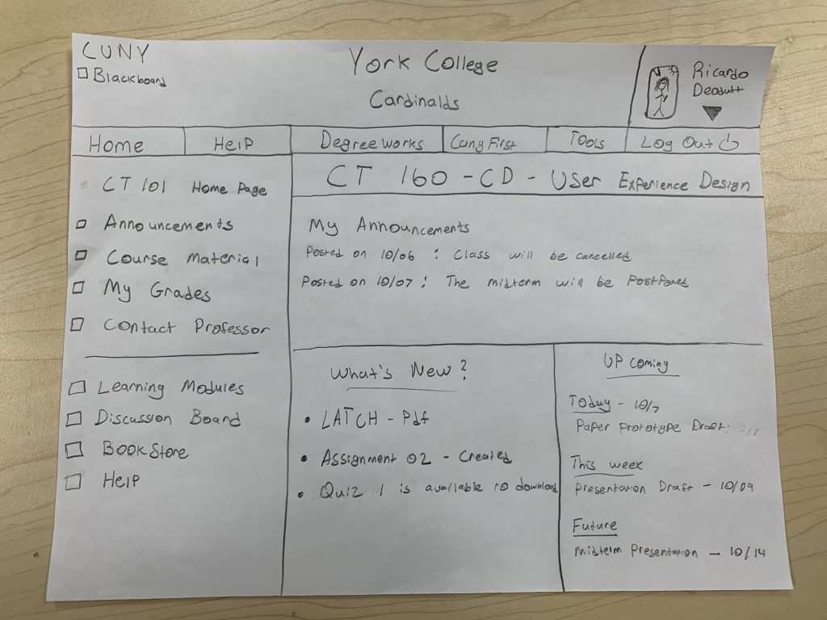
Uniform layout on all courses.

Slide 16
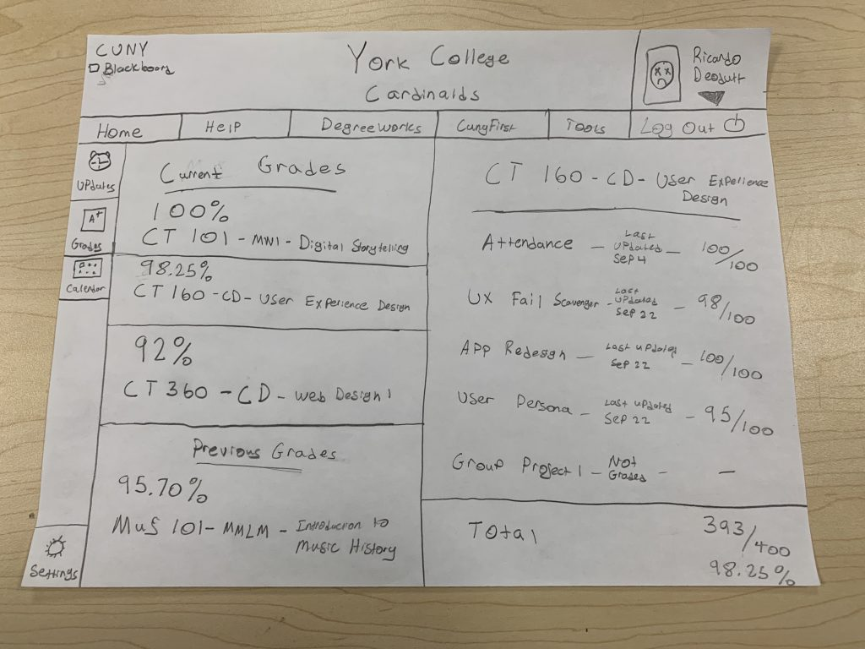
Grades are shown in percentages, and courses are filtered.

Slide 17
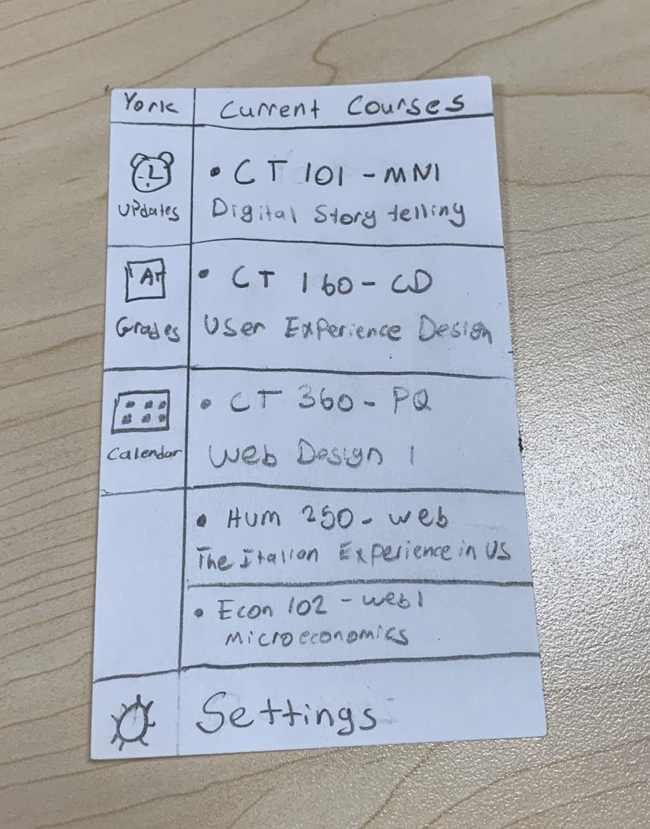
Course names are simplified and courses are filtered.

Slide 18
Notable Responses after Paper Prototype Testing
“I think there is a lot of content on a page, but you know where to go”.-Paragati K.
“A good suggestion is to have a toggle menu for the home page, but overall I liked it”. - Qadeer S.
“Put the help by the logout button”. - Marvin M.
“Have percentages for the grade section”. - Richie C.
“I like how it’s a grid and fills up space. It’s customizable and I feel with the trend right now”. Professor N.

Slide 19

Link to Adobe XD Design

Slide 20

Movie Walkthrough of website

Slide 21
Final Design Analysis

Slide 22
Conclusion
Overall,

